Slide 1


Francisco Samuel – Internet Consultant

Slide 2
Francisco Samuel
BS Computer Science
SMU - 1987
Torch Photographer

Slide 3
eCommerce Conference 2011
Search
Engine
Optimization

Slide 4
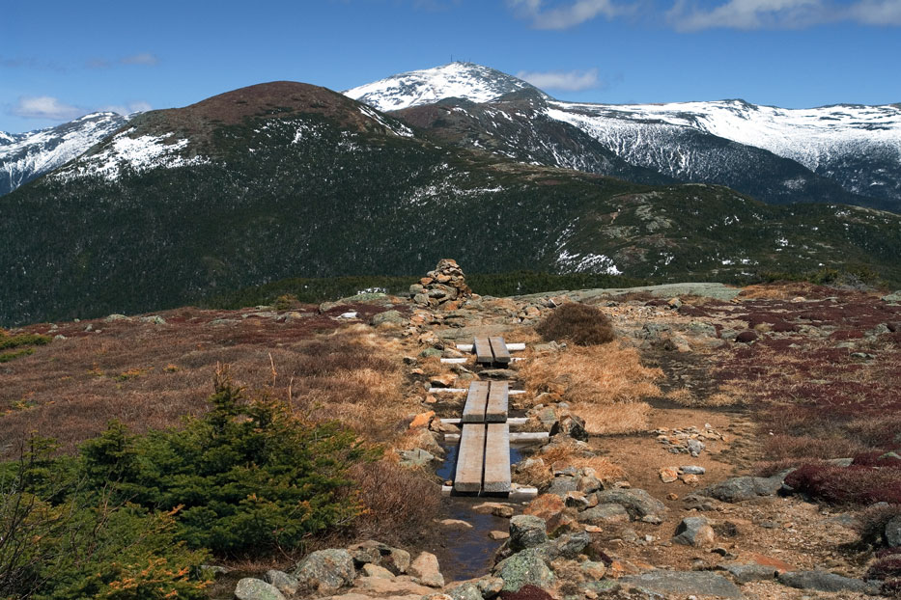
Mount Washington

Slide 5

YAHOO!
Yet Another Hierarchical Officious Oracle
Founded by Jerry Yang & David Filo
Based on categories and sub-categories
An exercise in sleep deprivation
Results were keyword driven

Slide 6

Keywords

Slide 7
Gaming Search Engine
<meta name="keywords" content="phpdesigner, php designer, php ide, php editor, php, ftp, sftp, apache, sex, porn, pamela anderson video, britney spears, xxx , sex, porn, pamela anderson video, britney spears, xxx , sex, porn, pamela anderson video, britney spears, xxx , sex, porn, pamela anderson video, britney spears, xxx , sex, porn, pamela anderson video, britney spears, xxx , sex, porn, pamela anderson video, britney spears, xxx , sex, porn, pamela anderson video, britney spears, xxx , sex, porn, pamela anderson video, britney spears, xxx , sex, porn, pamela anderson video, britney spears, xxx , sex, porn, pamela anderson video, britney spears, xxx , sex, porn, pamela anderson video, britney spears, xxx”>

Slide 8

Gaming Search Engine

Slide 9
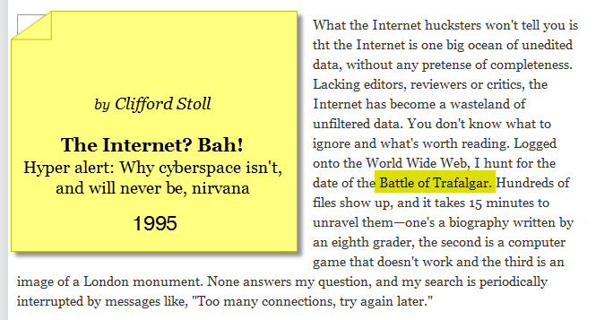
Search Engine Results Page – SERP

Slide 10
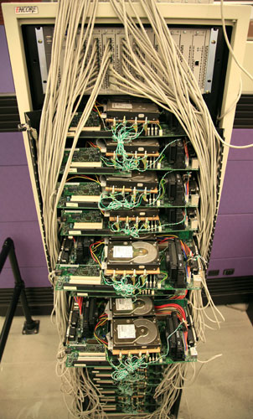
Google
Larry Page, Sergey Brin
Research project at Stanford University
Carl Page, Ph.D. CS 1965, a “pioneer in CS and AI“
Brin’s, born in Russia, his father and grandfather were mathmaticians

Slide 11
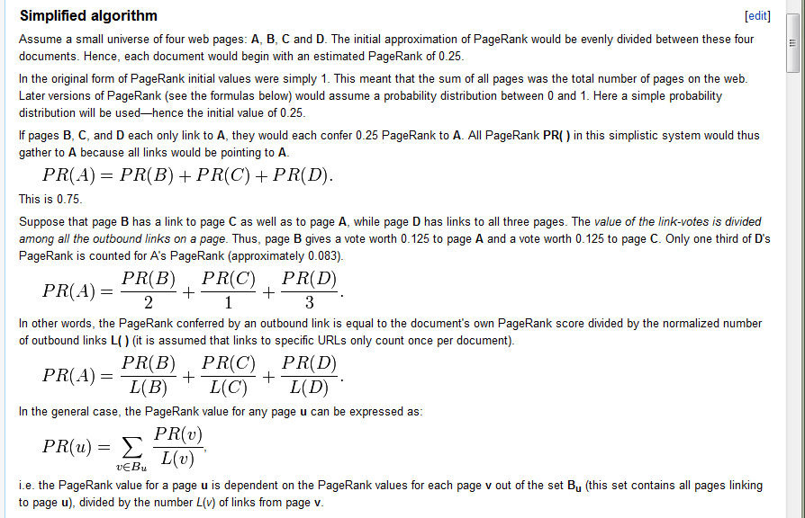
Page Rank Algorithm – PR

Slide 12
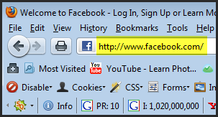
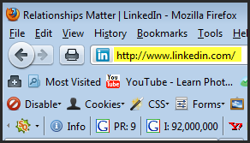
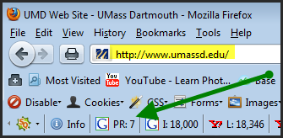
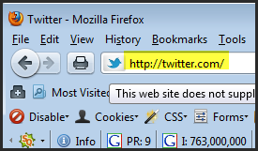
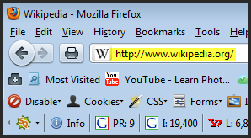
Page Rank

Slide 13
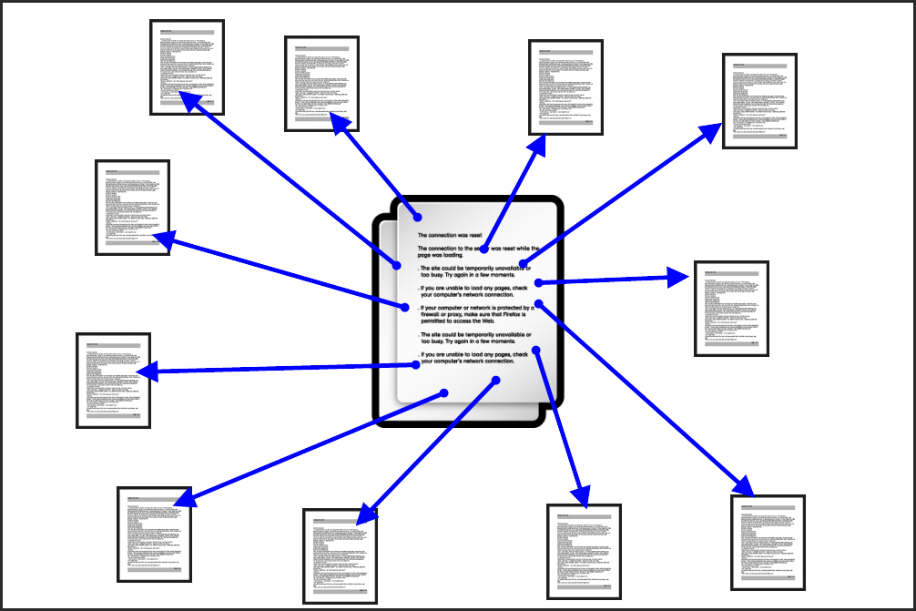
Links

Slide 14
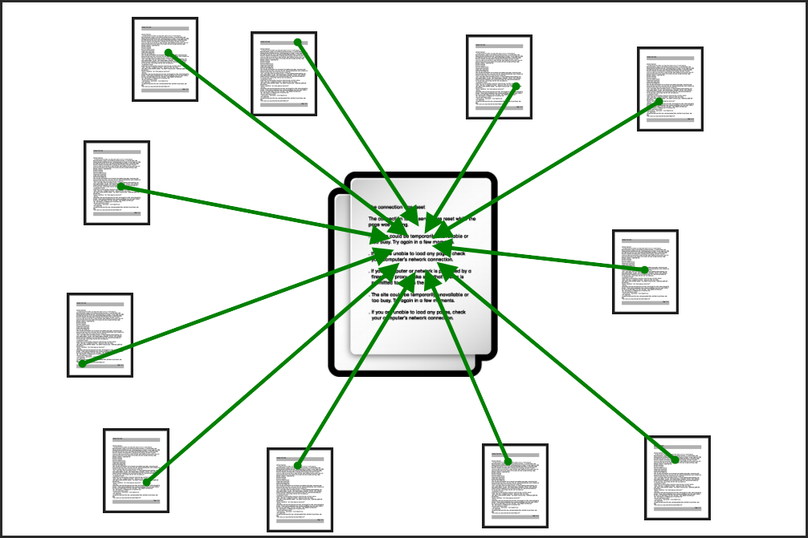
Links

Slide 15
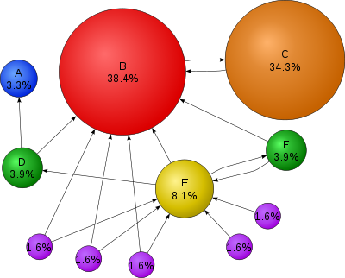
Page Rank – PR

Slide 16
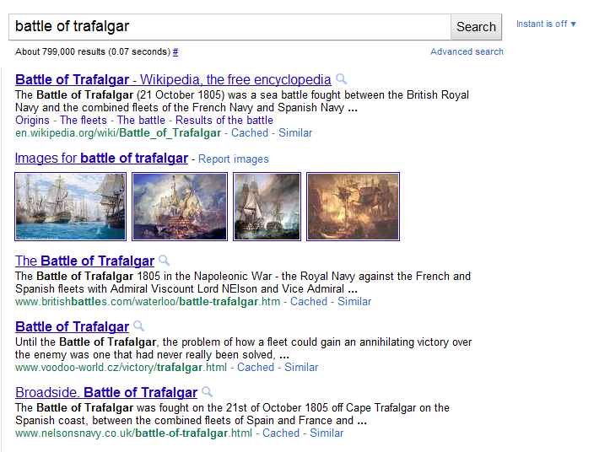
Search Engine Results Page – SERP

Slide 17
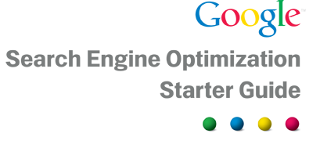
Google SEO Starter Guide

Slide 18
Google Webmaster Guide
Good product / service
Good content / Information architecture
Titles / Keywords
Site structure / Navigation
Anchor text / Image optimization
Header tags
robots.txt / sitemap.xml

Slide 19
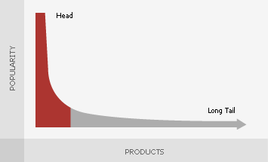
Marketing
Keyword research
Market research
Know your audience
Know your product / service
Study your competition
Develop a strategy / Plan
Chase the ‘long tail’,
not the head

Slide 20
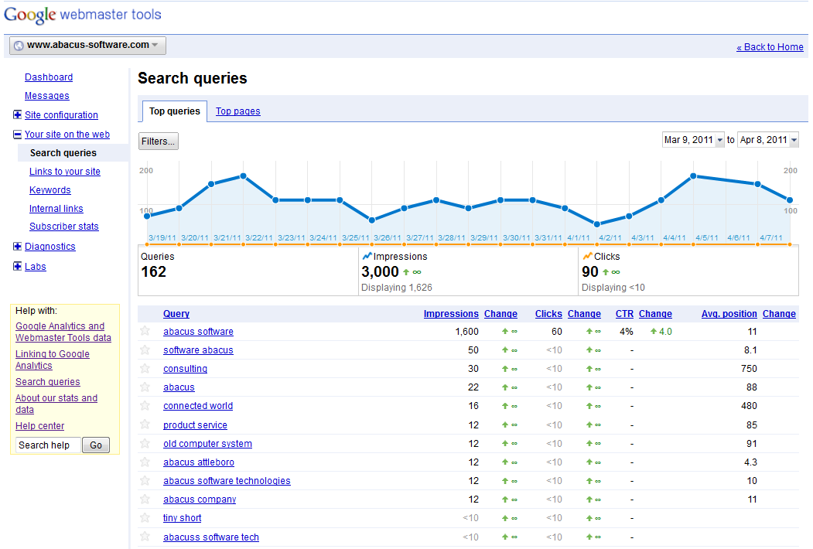
Google Webmaster Tools

Slide 21
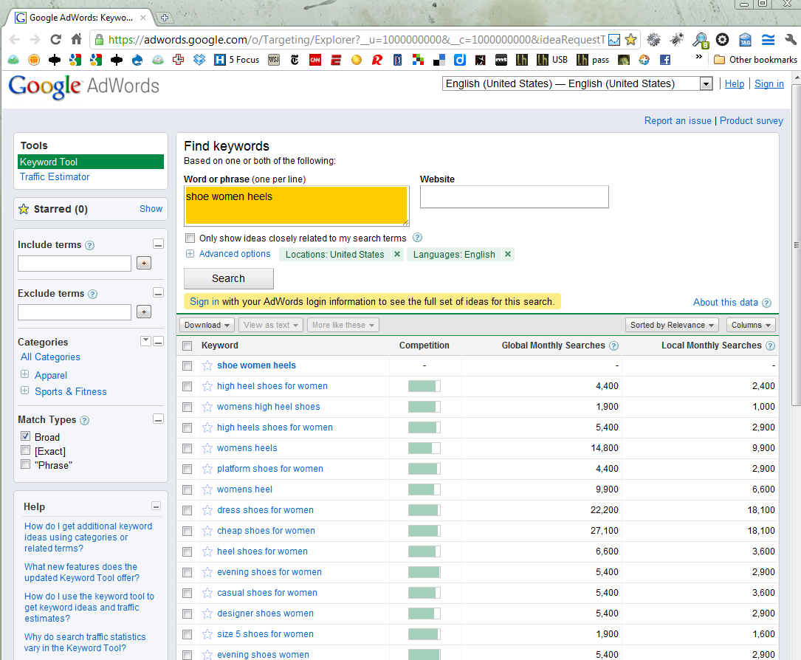
Google Keyword Analysis

Slide 22
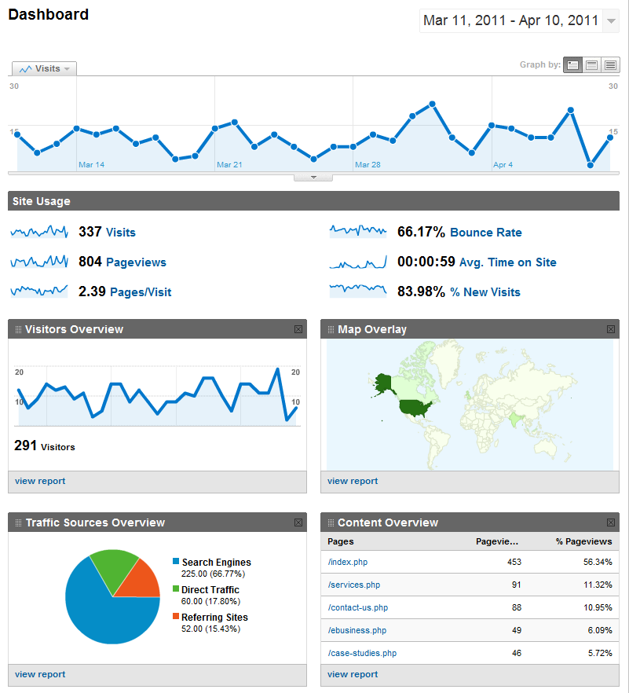
Google Analytics

Slide 23

Circle of Trust

Slide 24

Circle of Trust
Matt Cutts
I'm the head of the webspam team at Google.

Slide 25

Circle of Trust
Matt Cutts
Vanessa Fox
Creator/Developer of Webmaster Tools at Google.

Slide 26
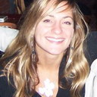
Circle of Trust
Matt Cutts
Lara Lippay
SEO Program Manager for Yahoo
Vanessa Fox

Slide 27
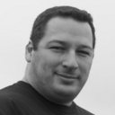
Circle of Trust
Matt Cutts
Lara Lippay
Search Quality Analyst @ Google... A Portuguese guy Tweeting about Google, SEO, Search & random stuff. I also blog in PT and EN... Yes I'm a Webspam assassin :)
Vanessa Fox
Pedro Dias

Slide 28

Circle of Trust
CEO & Co-Founder, SEOmoz
Matt Cutts
Lara Lippay
Rand Fishkin
Vanessa Fox
Pedro Dias

Slide 29

Circle of Trust
Matt Cutts
Lara Lippay
Rand Fishkin
Google Webmaster Tools provides you with detailed reports about your pages' visibility on Google.
Vanessa Fox
Pedro Dias
Google webmaster tools

Slide 30
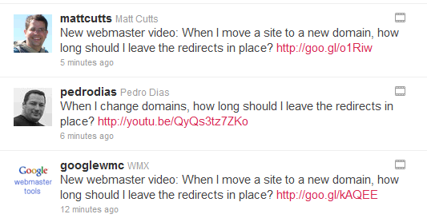
Validation

Slide 31
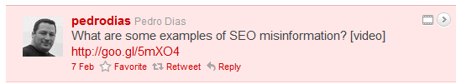


Validation

Slide 32
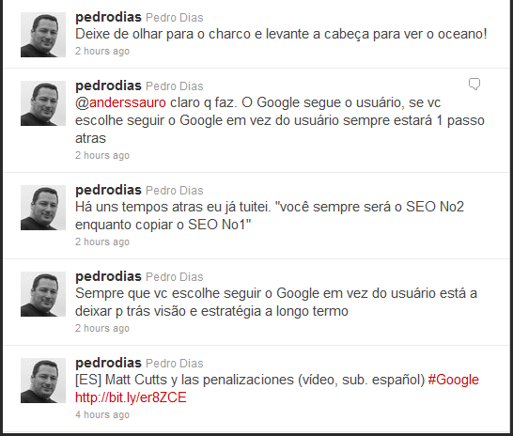
Internet is Global

Slide 33
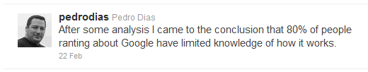


Some Random Tweets

Slide 34
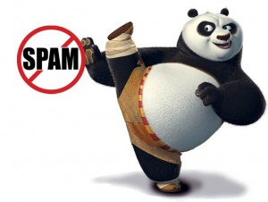
Panda

Slide 35
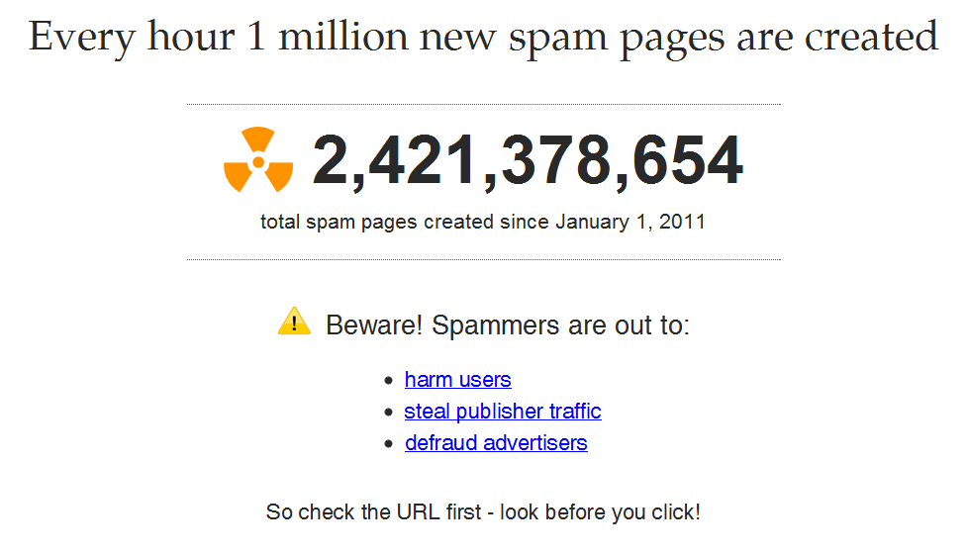
Spam Clock

Slide 36
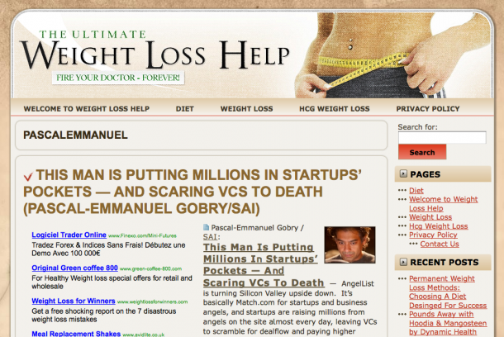
Content Farms

Slide 37
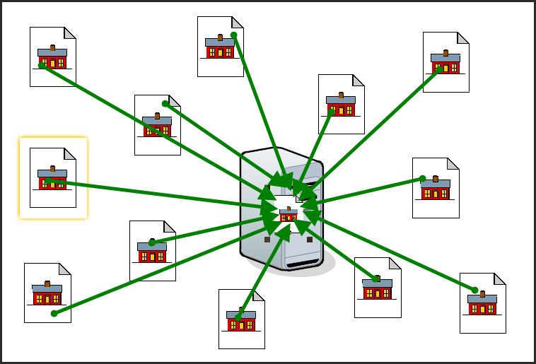
Content Farm Links

Slide 38
Link Building
Sponsor a local charity
Sponsor a local business event
Speak at local events
Create your own event
Vendors in exchange for promotions
Testimonials for products/services
Link in blog/newsletter
Write press-releases
Exchange links with clients

Slide 39


Google Strikes Back
The Dirty Little Secrets of Search – NY Times – (jcpenny.com)
Google Penalizes Overstock for Search Tactics – NY Times (overstock.com)

Slide 40
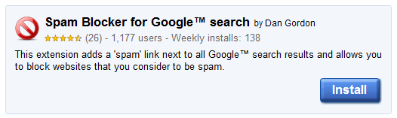
Panda
Algorithm change
Targeted at content farms
Targeted at low quality content (schemes)
Some sites were effected (10%)
Companies were irate and demanded an explanation

Slide 41
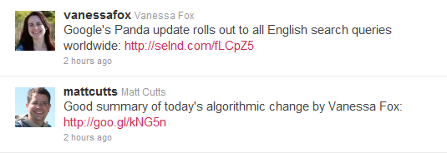
Panda

Slide 42
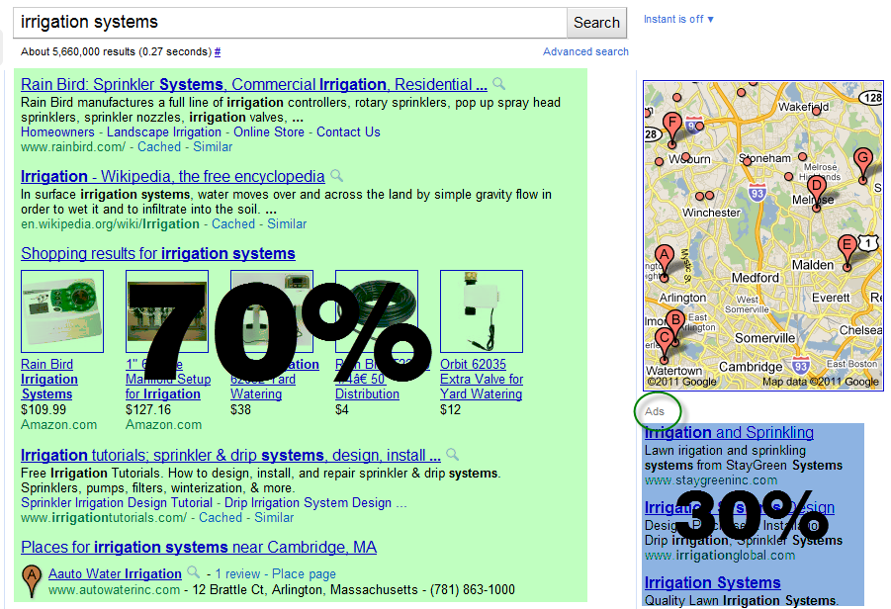
0 * 70% = Zero

Slide 43







Social Media – Does it Rank?

Slide 44

Going Mobile – Smartphones

Slide 45
Mobile Numbers (2010)
There are 1 Billion mobile devices in the world
12% of Google searches were from a mobile device
50% of mobile users search
Average American spends 2.7 hours/day
33% of Facebook’s 600+ Millions users
50% of Twitter’s 165+ Million users
200+ Million daily views on YouTube
Women 35-54 are most active
Web site optimization for mobile

Slide 46
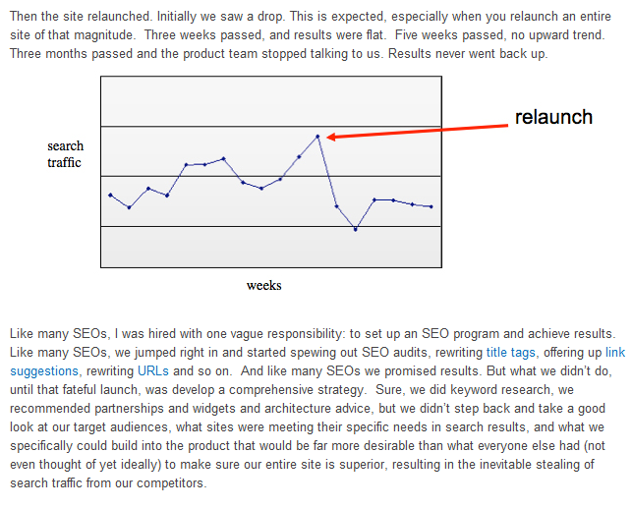
SEO Experts

Slide 47
Anchor Tag
To subscribe to our newsletter Click Here
Subscribe to our newsletter

Slide 48
Francisco Samuel
me@franciscosamuel.com
508 243-0999
@franciscosamuel

